Slide 1


UNITED
WE CURE

Slide 2

TITLE SLIDE

Slide 3

SECTION

Slide 4

SECTION/SLIDE HEADER
Topic Headline
Topic bullet point
Topic bullet point

Slide 5
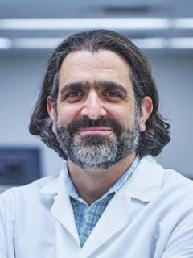
“CBTN possesses an unprecedented collection of data-driven resources built to overcome research bottlenecks so breakthroughs are made faster. CBTN is a worldwide partnership sharing the groundbreaking science that is bringing
us closer to cures.”
NAME, MD, PhD, MAS
Position,
Institution

Slide 6

“CBTN possesses an unprecedented collection of data-driven resources built to overcome research bottlenecks so breakthroughs are made faster. CBTN is a worldwide partnership sharing the groundbreaking science that is bringing
us closer to cures.”
NAME, MD, PhD, MAS
Position,
Institution

Slide 7






A RESEARCH POWERHOUSE
220+
442+
8000+
peer-reviewed publications
research projects
patient & family participants
35
23
85,000
member institutions
family
foundations
biospecimens

Slide 8





CBTN COMMERCIAL PARTNERSHIPS
PRECLINICAL MODEL LICENSING
180+ preclinical models (organoids,
cell lines)
SPONSORED RESEARCH
Target discovery, biomarker validation,
clinical trial drug screening
CLINICAL TRIAL SUPPORT
External control arms, real-world evidence collection
NATURAL HISTORY STUDIES
Longitudinal tracking of rare tumor populations
OFF-LABEL DRUG REGISTRIES
Generating data to support expanded indications

Slide 9




END-TO-END RESEARCH SOLUTIONS
Basic Research &
Target Identification
Tumor subtyping,
AI-driven discovery, preclinical models
Clinical Outcome Analysis
Predictive modeling, AI-driven insights
Target Pharmacology
& Biomarker Development
Assay validation,
drug indications
Clinical Trial Support External control arms, regulatory data generation

Slide 10


THANK
YOU

